Slide 1

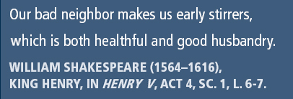
Principles of Information Security,
Fifth Edition
Chapter 2
The Need for Security

Slide 2
Learning Objectives
Upon completion of this material, you should be able to:
  Discuss the organizational business need for information security
  Explain why a successful information security program is the shared responsibility of an organization’s general management and IT management
  List and describe the threats posed to information security and common attacks associated with those threats
  Describe the relationship between threats and attacks against information within systems
Principles of Information Security, Fifth Edition
Notes:
Upon completion of this material, you should be able to:
Discuss the organizational business need for information security
Explain why a successful information security program is the shared responsibility of an organization’s general management and IT management
List and describe the threats posed to information security and common attacks associated with those threats
Describe the relationship between threats and attacks against information within systems

Slide 3
Introduction
The primary mission of an information security program is to ensure information assets—information and the systems that house them—remain safe and useful.
If no threats existed, resources could be used exclusively to improve systems that contain, use, and transmit information.
Threat of attacks on information systems is a constant concern.
Principles of Information Security, Fifth Edition
Notes:
Introduction
Primary mission of an information security program is to ensure information assets-information and the systems that house them-remain safe and useful
If no threats existed, resources could be used exclusively to improve systems that contain, use, and transmit information
Threat of attacks on information systems is a constant concern

Slide 4
Business Needs First
Information security performs four important functions for an organization:
  Protecting the organization’s ability to function
  Protecting the data and information the organization collects and uses
  Enabling the safe operation of applications running on the organization’s IT systems
  Safeguarding the organization’s technology assets
Principles of Information Security, Fifth Edition
Notes:
Business Needs First, Technology Needs Last
Information security performs four important functions for an organization
Protecting the organization’s ability to function
Protecting the data and information the organization collects and uses
Enabling the safe operation of applications running on the organization’s IT systems
Safeguarding the organization’s technology assets

Slide 5
Protecting the Functionality of an Organization
Management (general and IT) is responsible for facilitating security program.
Implementing information security has more to do with management than technology.
Communities of interest should address information security in terms of business impact and cost of business interruption.
Principles of Information Security, Fifth Edition
Notes:
Protecting the Ability of the Organization to Function
Management (general and IT) responsible for facilitating security program
Implementing information security has more to do with management than technology
Communities of interest should address information security in terms of business impact and cost of business interruption

Slide 6
Protecting Data That Organizations Collect and Use
Without data, an organization loses its record of transactions and ability to deliver value to customers.
Protecting data in transmission, in processing, and at rest (storage) is a critical aspect of information security.
Principles of Information Security, Fifth Edition
Notes:
Protecting Data That Organizations Collect and Use
Without data, an organization loses its record of transactions and ability to deliver value to customers
Protecting data in transmission, in processing, and at rest (storage) are critical aspects of information security

Slide 7
Enabling the Safe Operation of Applications
Organization needs environments that safeguard applications using IT systems.
Management must continue to oversee infrastructure once in place—not relegate to IT department.
Principles of Information Security, Fifth Edition
Notes:
Enabling the Safe Operation of Applications
Today’s organizations are under immense pressure to create and operate integrated, efficient, and capable applications.
The modern organization needs to create an environment that safeguards applications using the organization’s IT systems, particularly the environment of the organization’s infrastructure.
Once the infrastructure is in place, management must understand it has not abdicated to the IT department its responsibility to make choices and enforce decisions, but must continue to oversee the infrastructure.

Slide 8
Safeguarding Technology Assets in Organizations
Organizations must employ secure infrastructure hardware appropriate to the size and scope of the enterprise.
Additional security services may be needed as the organization grows.
More robust solutions should replace security programs the organization has outgrown.
Principles of Information Security, Fifth Edition
Notes:
Safeguarding the Technology Assets in Organizations
Organizations must employ secure infrastructure hardware appropriate to size and scope of enterprise
Additional security services may be needed as organization grows
More robust solutions should replace security programs the organization has outgrown

Slide 9
Threats
Threat: a potential risk to an asset’s loss of value
Management must be informed about the various threats to an organization’s people, applications, data, and information systems.
Overall security is improving, so is the number of potential hackers.
The 2010–2011 CSI/FBI survey found
  67.1 percent of organizations had malware infections.
  11 percent indicated system penetration by an outsider.
Principles of Information Security, Fifth Edition
Notes:
Threats to Information Security
Threat: a potential risk to an asset’s loss of value
Management must be informed about the various threats to organization’s people, applications, data, and information systems
Overall security is improving; so is number of potential hackers
The 2010-2011 CSI/FBI survey found
67.1 percent of organizations had malware infections
11 percent indicated system penetration by an outsider

Slide 10
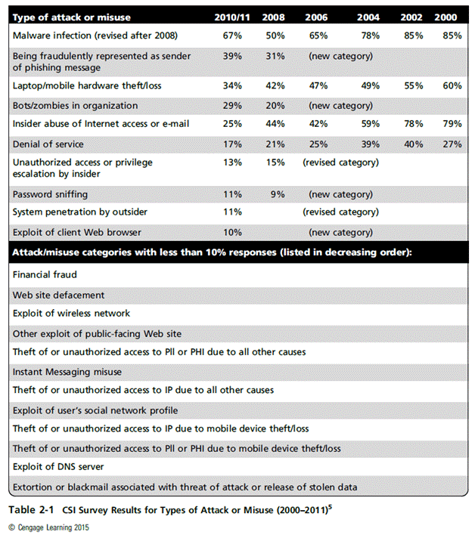
Principles of Information Security, Fifth Edition

Slide 11
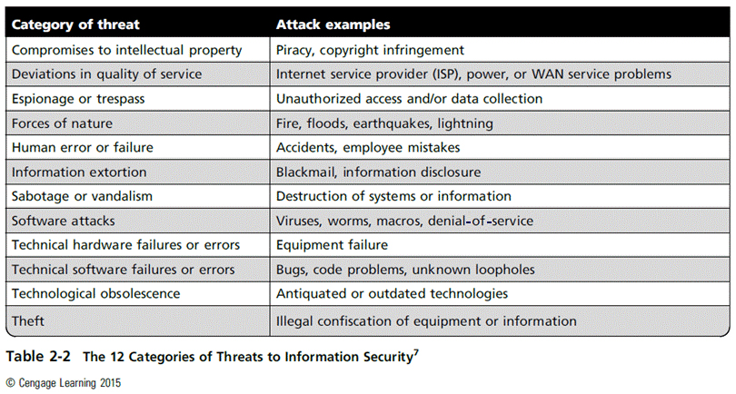
Principles of Information Security, Fifth Edition

Slide 12
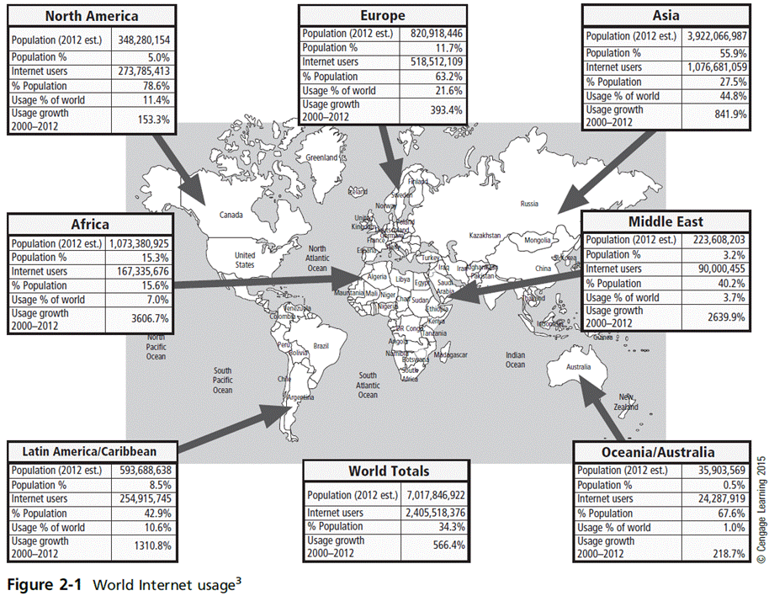
Principles of Information Security, Fifth Edition

Slide 13
Compromises to Intellectual Property
Intellectual property (IP): creation, ownership, and control of original ideas as well as the representation of those ideas
The most common IP breaches involve software piracy.
Two watchdog organizations investigate software abuse:
  Software & Information Industry Association (SIIA)
  Business Software Alliance (BSA)‏
Enforcement of copyright law has been attempted with technical security mechanisms.
Principles of Information Security, Fifth Edition
Notes:
Compromises to Intellectual Property
Many organizations create or support the development of intellectual property as part of their business operations.
Intellectual property is defined as “the ownership of ideas and control over the tangible or virtual representation of those ideas.”
Intellectual property for an organization includes trade secrets, copyrights, trademarks, and patents.
Once intellectual property (IP) has been defined and properly identified, breaches to IP constitute a threat to the security of this information.
Most common IP breaches involve the unlawful use or duplication of software-based intellectual property, known as software piracy.
In addition to the laws surrounding software piracy, two watchdog organizations investigate allegations of software abuse: Software & Information Industry Association (SIIA), formerly the Software Publishers Association, and the Business Software Alliance (BSA).
Enforcement of copyright violations, piracy, and the like has been attempted through a number of technical security mechanisms, including digital watermarks, embedded codes.

Slide 14
Deviations in Quality of Service
Information system depends on the successful operation of many interdependent support systems.
Internet service, communications, and power irregularities dramatically affect the availability of information and systems.
Principles of Information Security, Fifth Edition
Notes:
Potential Deviations in Quality of Service by Service Providers
This category represents situations in which a product or services are not delivered to the organization as expected.
The organization’s information system depends on the successful operation of many interdependent support systems including power grids, telecom networks, parts suppliers, service vendors, and even the janitorial staff and garbage haulers.
Internet service, communications, and power irregularities are three sets of service issues that dramatically affect the availability of information and systems.

Slide 15
Deviations in Quality of Service (cont’d)
Internet service issues
  Internet service provider (ISP) failures can considerably undermine the availability of information.
  Outsourced Web hosting provider assumes responsibility for all Internet services as well as for the hardware and Web site operating system software.
Communications and other service provider issues
  Other utility services affect organizations: telephone, water, wastewater, trash pickup.
  Loss of these services can affect organization’s ability to function.
Principles of Information Security, Fifth Edition
Notes:
Internet Service Issues
For organizations that rely heavily on the Internet and the Web to support continued operations, the threat of the potential loss of Internet service can lead to considerable loss in the availability of information.
Many organizations have sales staff and telecommuters working at remote locations.
When an organization places its Web servers in the care of a Web hosting provider, that outsourcer assumes responsibility for all Internet services as well as for the hardware and operating system software used to operate the Web site.
Communications and Other Service Provider Issues
Other utility services can impact organizations as well.
Among these are telephone, water, wastewater, trash pickup, cable television, natural or propane gas, and custodial services.
The threat of loss of these services can lead to the inability of an organization to function properly.

Slide 16
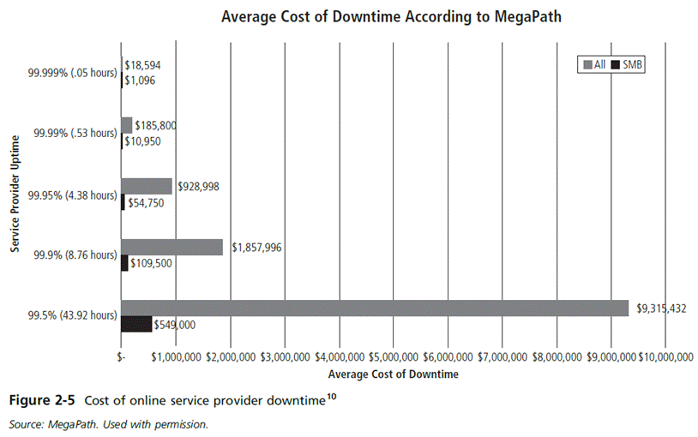
Principles of Information Security, Fifth Edition

Slide 17
Deviations in Quality of Service (cont’d)
Power irregularities
  Commonplace
  Lead to fluctuations such as power excesses, power shortages, and power losses
  Sensitive electronic equipment vulnerable to and easily damaged/destroyed by fluctuations
  Controls can be applied to manage power quality.
Principles of Information Security, Fifth Edition
Notes:
Power Irregularities
The threat of irregularities from power utilities is common and can lead to fluctuations such as power excesses, power shortages, and power losses.
In the U.S., buildings are “fed” 120-volt, 60-cycle power usually through 15 and 20 amp circuits.
Voltage levels can:
spike – momentary increase or surge – prolonged increase
sag – momentary low voltage, or brownout – prolonged drop
fault – momentary loss of power, or blackout – prolonged loss
Since sensitive electronic equipment, especially networking equipment, computers, and computer-based systems are susceptible to fluctuations, controls can be applied to manage power quality.

Slide 18
Espionage or Trespass
Access of protected information by unauthorized individuals
Competitive intelligence (legal) versus industrial
espionage (illegal)‏
Shoulder surfing can occur anywhere a person accesses confidential information.
Controls let trespassers know they are encroaching on organization’s cyberspace.
Hackers use skill, guile, or fraud to bypass controls protecting others’ information.
Principles of Information Security, Fifth Edition
Notes:
Deliberate Acts of Espionage or Trespass
This threat represents a well-known and broad category of electronic and human activities that breach the confidentiality of information.
When an unauthorized individual gains access to the information an organization is trying to protect, that act is categorized as a deliberate act of espionage or trespass.
When information gatherers employ techniques that cross the threshold of what is legal and/or ethical, they enter the world of industrial espionage.
Instances of shoulder surfing occur at computer terminals, desks, ATM machines, public phones, or other places where a person is accessing confidential information.
The threat of trespass can lead to unauthorized real or virtual actions that enable information gatherers to enter premises or systems they have not been authorized to enter.
Controls are sometimes implemented to mark the boundaries of an organization’s virtual territory.
These boundaries give notice to trespassers that they are encroaching on the organization’s cyberspace.
The classic perpetrator of deliberate acts of espionage or trespass is the hacker.
In the gritty world of reality, a hacker uses skill, guile, or fraud to attempt to bypass the controls placed around information that is the property of someone else. The hacker frequently spends long hours examining the types and structures of the targeted systems.

Slide 19
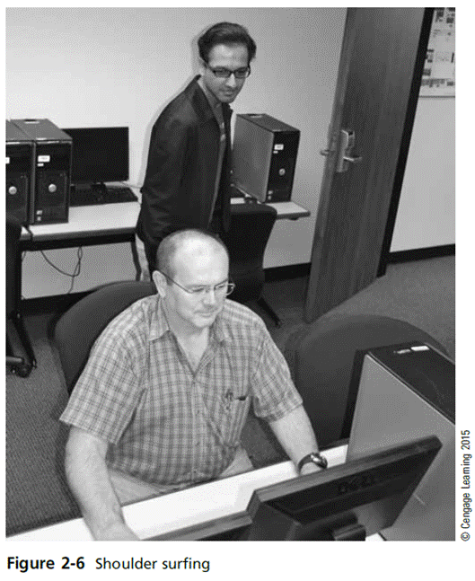
Principles of Information Security, Fifth Edition

Slide 20
Espionage or Trespass (cont’d)‏
Expert hacker
  Develops software scripts and program exploits
  Usually a master of many skills
  Will often create attack software and share with others
Unskilled hacker
  Many more unskilled hackers than expert hackers
  Use expertly written software to exploit a system
  Do not usually fully understand the systems they hack
Principles of Information Security, Fifth Edition
Notes:
Deliberate Acts of Espionage or Trespass (continued)
There are generally two skill levels among hackers.
The first is the expert hacker, who develops software scripts and codes exploits used by the second category, the novice, or unskilled hacker.
The expert hacker is usually a master of several programming languages, networking protocols, and operating systems and also exhibits a mastery of the technical environment of the chosen targeted system.
However, expert hackers have now become bored with directly attacking systems and have turned to writing software.
The software they are writing are automated exploits that allow novice hackers to become script kiddies, hackers of limited skill who use expert-written software to exploit a system but do not fully understand or appreciate the systems they hack.
As a result of preparation and continued vigilance, attacks conducted by scripts are usually predictable and can be adequately defended against.
There are other terms for system rule breakers:
The term cracker is now commonly associated with an individual who “cracks” or removes the software protection from an application designed to prevent unauthorized duplication.
A phreaker hacks the public telephone network to make free calls, disrupt services, and generally wreak havoc.

Slide 21
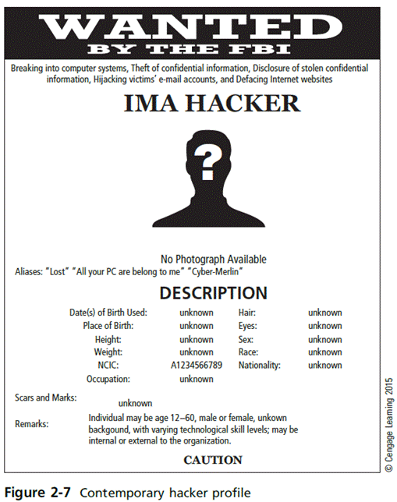
Principles of Information Security, Fifth Edition

Slide 22
Espionage or Trespass (cont’d)‏
Other terms for system rule breakers:
  Cracker: “cracks” or removes software protection designed to prevent unauthorized duplication
  Phreaker: hacks the public telephone system to make free calls or disrupt services
Password attacks
  Cracking
  Brute force
  Dictionary
  Rainbow tables
  Social engineering
Principles of Information Security, Fifth Edition
Notes:
Deliberate Acts of Espionage or Trespass (continued)
There are generally two skill levels among hackers.
The first is the expert hacker, who develops software scripts and codes exploits used by the second category, the novice, or unskilled hacker.
The expert hacker is usually a master of several programming languages, networking protocols, and operating systems and also exhibits a mastery of the technical environment of the chosen targeted system.
However, expert hackers have now become bored with directly attacking systems and have turned to writing software.
The software they are writing are automated exploits that allow novice hackers to become script kiddies, hackers of limited skill who use expert-written software to exploit a system but do not fully understand or appreciate the systems they hack.
As a result of preparation and continued vigilance, attacks conducted by scripts are usually predictable and can be adequately defended against.
There are other terms for system rule breakers:
The term cracker is now commonly associated with an individual who “cracks” or removes the software protection from an application designed to prevent unauthorized duplication.
A phreaker hacks the public telephone network to make free calls, disrupt services, and generally wreak havoc.

Slide 23
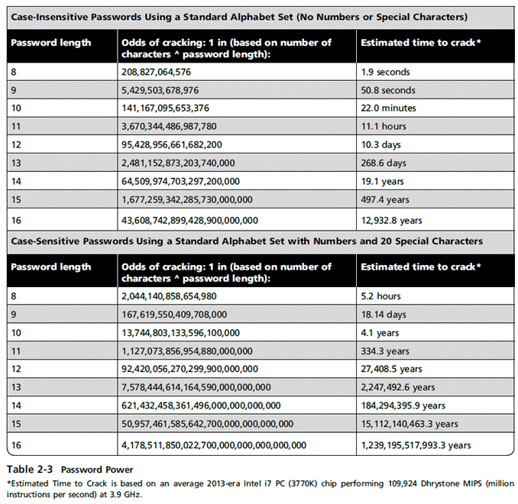
Principles of Information Security, Fifth Edition

Slide 24
Forces of Nature
Forces of nature can present some of the most dangerous threats.
They disrupt not only individual lives, but also storage, transmission, and use of information.
Organizations must implement controls to limit damage and prepare contingency plans for continued operations.
Principles of Information Security, Fifth Edition
Notes:
Forces of Nature
Forces of nature, force majeure, or acts of God pose the most dangerous threats, because they are unexpected and can occur with very little warning.
These threats can disrupt not only the lives of individuals, but also the storage, transmission, and use of information.
These include fire, flood, earthquake, lightning, landslide or mudslide, tornado or severe windstorm, hurricane or typhoon, tsunami, electrostatic discharge, and dust contamination.
Since it is not possible to avoid many of these threats, management must implement controls to limit damage and also prepare contingency plans for continued operations.

Slide 25
Human Error or Failure
Includes acts performed without malicious intent or in ignorance
Causes include:
  Inexperience
  Improper training
  Incorrect assumptions
Employees are among the greatest threats to an organization’s data.
Principles of Information Security, Fifth Edition
Notes:
Potential Acts of Human Error or Failure
This category includes the possibility of acts performed without intent or malicious purpose by an individual who is an employee of an organization.
Inexperience, improper training, the making of incorrect assumptions, and other circumstances can cause problems.
Employees constitute one of the greatest threats to information security, as the individuals closest to the organizational data.
Employee mistakes can easily lead to the following: revelation of classified data, entry of erroneous data, accidental deletion or modification of data, storage of data in unprotected areas, and failure to protect information.
Many threats can be prevented with controls, ranging from simple procedures, such as requiring the user to type a critical command twice, to more complex procedures, such as the verification of commands by a second party.

Slide 26
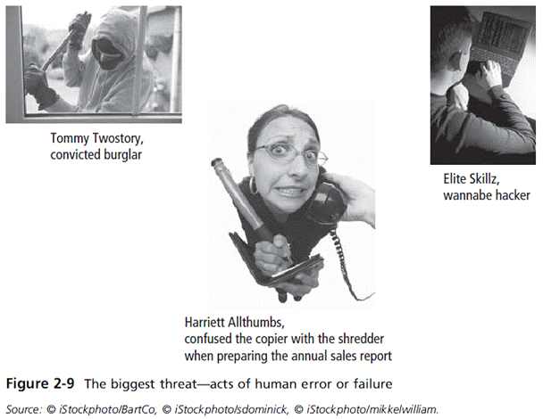
Principles of Information Security, Fifth Edition
Notes:
Elite Skillz, wannabe hacker, is my favorite part of this entire chapter. I am laughing entirely too hard.

Slide 27
Human Error or Failure (cont’d)‏
Employee mistakes can easily lead to:
  Revelation of classified data
  Entry of erroneous data
  Accidental data deletion or modification
  Data storage in unprotected areas
  Failure to protect information
Many of these threats can be prevented with training, ongoing awareness activities, and controls.
Social engineering uses social skills to convince people to reveal access credentials or other valuable information to an attacker.
Principles of Information Security, Fifth Edition
Notes:
Human Error or Failure
Employee mistakes can easily lead to:
Revelation of classified data
Entry of erroneous data
Accidental data deletion or modification
Data storage in unprotected areas
Failure to protect information
Many of these threats can be prevented with controls

Slide 28
Social Engineering‏
“People are the weakest link. You can have the best technology; firewalls, intrusion-detection systems, biometric devices ... and somebody can call an unsuspecting employee. That's all she wrote, baby. They got everything.”—Kevin Mitnick
Advance-fee fraud: indicates recipient is due money and small advance fee/personal banking information required to facilitate transfer
Phishing: attempt to gain personal/confidential information; apparent legitimate communication hides embedded code that redirects user to third-party site
Principles of Information Security, Fifth Edition
Notes:
Attack Descriptions (continued)
Social Engineering - Within the context of information security, the process of using social skills to convince people to reveal access credentials or other valuable information to the attacker.
“People are the weakest link. You can have the best technology; firewalls, intrusion-detection systems, biometric devices...and somebody can call an unsuspecting employee. That's all she wrote, baby. They got everything.”
Timing Attack - Relatively new, works by exploring the contents of a Web browser’s cache. This could allow the designer to collect information to access to password-protected sites. Another attack by the same name involves attempting to intercept cryptographic elements to determine keys and encryption algorithms.

Slide 29
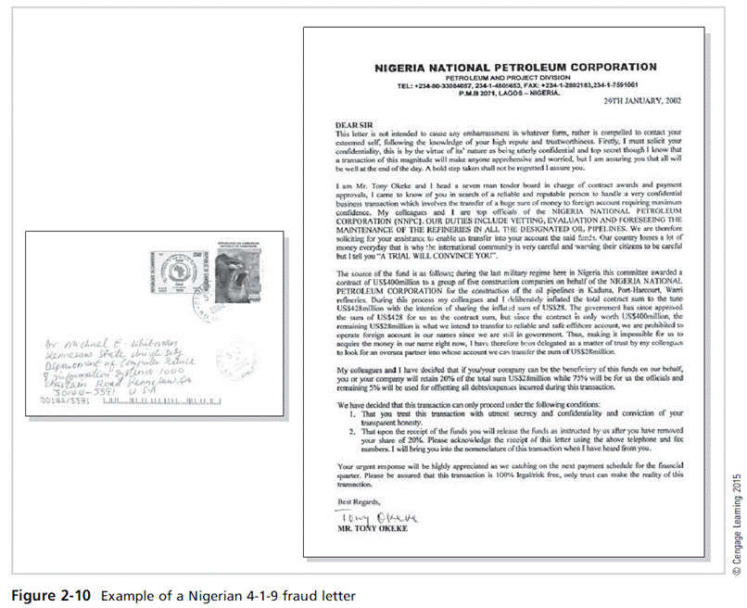
Principles of Information Security, Fifth Edition

Slide 30
Information Extortion
Attacker steals information from a computer system and demands compensation for its return or nondisclosure. Also known as cyberextortion.
Commonly done in credit card number theft
Principles of Information Security, Fifth Edition
Notes:
Deliberate Acts of Information Extortion
The threat of information extortion is the possibility of an attacker or formerly trusted insider stealing information from a computer system and demanding compensation for its return or for an agreement to not disclose the information.
Extortion is common in credit card number theft.

Slide 31
Software Attacks
Malicious software (malware) is used to overwhelm the processing capabilities of online systems or to gain access to protected systems via hidden means.
Software attacks occur when an individual or a group designs and deploys software to attack a system.
Principles of Information Security, Fifth Edition
Notes:
Software Attacks
Malicious software (malware) deployed to overwhelm processing capabilities of online systems or gain access to protected systems via hidden means
Include:
Viruses
Worms
Trojan horses
Polymorphic threats
Virus and worm hoaxes
Back door or trap door
Denial-of-service and distributed denial-of-service
Mail bomb

Slide 32
Software Attacks (cont’d)
Types of attacks include:
  Malware (malicious code): It includes the execution of viruses, worms, Trojan horses, and active Web scripts with the intent to destroy or steal information.
    Virus: It consists of code segments that attach to existing program and take control of access to the targeted computer.
    Worms: They replicate themselves until they completely fill available resources such as memory and hard drive space.
    Trojan horses: malware disguised as helpful, interesting, or necessary pieces of software
Principles of Information Security, Fifth Edition
Notes:
Attacks
An attack is the deliberate act that exploits vulnerability.
It is accomplished by a threat agent to damage or steal an organization’s information or physical asset.
An exploit is a technique to compromise a system. Vulnerability is an identified weakness of a controlled system whose controls are not present or are no longer effective. An attack is then the use of an exploit to achieve the compromise of a controlled system.
Malicious Code
This kind of attack includes the execution of viruses, worms, Trojan horses, and active Web scripts with the intent to destroy or steal information.
The state of the art in attacking systems in 2002 is the multivector worm.
These attack programs use up to six known attack vectors to exploit a variety of vulnerabilities in commonly found information system devices.

Slide 33
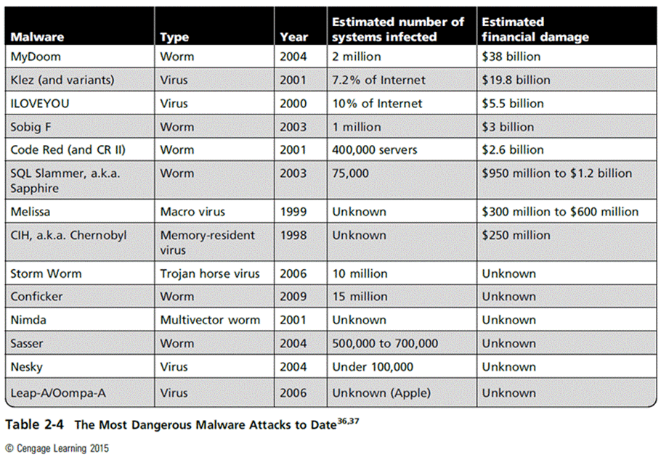
New Table
Principles of Information Security, Fifth Edition

Slide 34
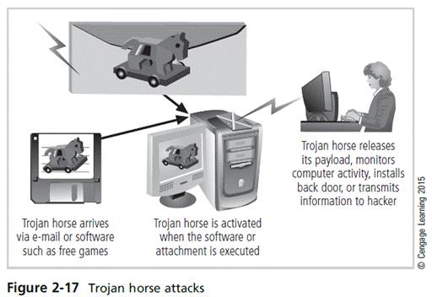
Principles of Information Security, Fifth Edition

Slide 35
Software Attacks (cont’d)‏
Types of attacks (cont’d)
  Denial-of-service (DoS): An attacker sends a large number of connection or information requests to a target.
    The target system becomes overloaded and cannot respond to legitimate requests for service.
    It may result in system crash or inability to perform ordinary functions.
  Distributed denial-of-service (DDoS): A coordinated stream of requests is launched against a target from many locations simultaneously.
Principles of Information Security, Fifth Edition
Notes:
Attack Descriptions (continued)
Denial-of-Service (DoS) - The attacker sends a large number of connection or information requests to a target. So many requests are made that the target system cannot handle them successfully along with other, legitimate requests for service. This may result in a system crash or merely an inability to perform ordinary functions.
Distributed Denial-of-Service (DDoS) - An attack in which a coordinated stream of requests is launched against a target from many locations at the same time.

Slide 36
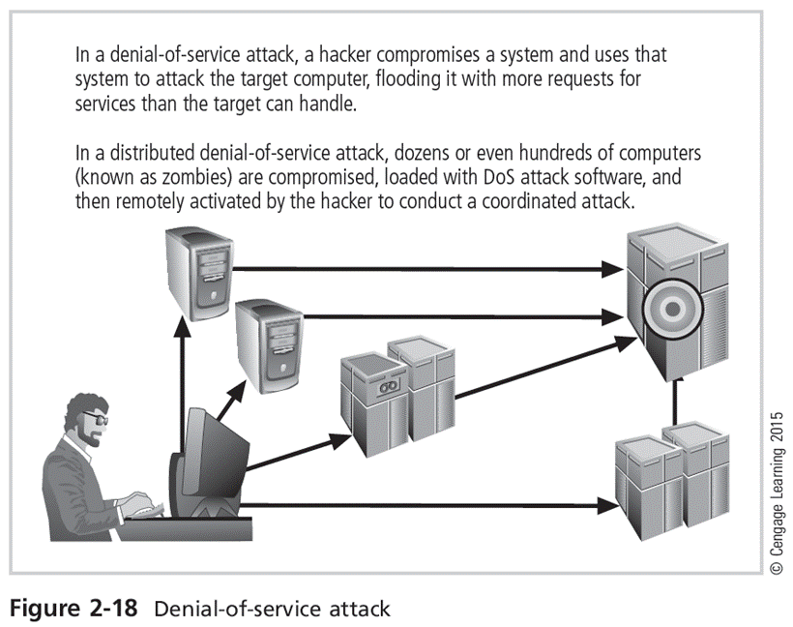
Principles of Information Security, Fifth Edition

Slide 37
Software Attacks (cont’d)‏
Types of attacks (cont’d)
  Mail bombing (also a DoS): An attacker routes large quantities of e-mail to target to overwhelm the receiver.
  Spam (unsolicited commercial e-mail): It is considered more a nuisance than an attack, though is emerging as a vector for some attacks.
  Packet sniffer: It monitors data traveling over network; it can be used both for legitimate management purposes and for stealing information from a network.
  Spoofing: A technique used to gain unauthorized access; intruder assumes a trusted IP address.
Principles of Information Security, Fifth Edition
Notes:
Attack Descriptions (continued)
Spoofing - A technique used to gain unauthorized access to computers, whereby the intruder sends messages to a computer with an IP address indicating that the message is coming from a trusted host.
Man-in-the-Middle - In the man-in-the-middle or TCP hijacking attack, an attacker sniffs packets from the network, modifies them, and inserts them back into the network.
Spam - Unsolicited commercial e-mail. While many consider spam a nuisance rather than an attack, it is emerging as a vector for some attacks.
Mail Bombing - Another form of e-mail attack that is also a DoS, in which an attacker routes large quantities of e-mail to the target.

Slide 38
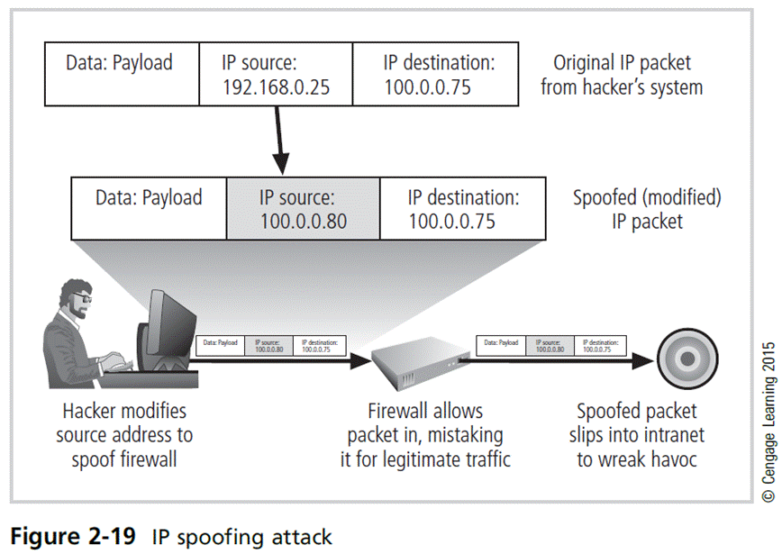
Principles of Information Security, Fifth Edition

Slide 39
Software Attacks (cont’d)‏
Types of attacks (cont’d)
  Pharming: It attacks a browser’s address bar to redirect users to an illegitimate site for the purpose of obtaining private information.
  Man-in-the-middle: An attacker monitors the network packets, modifies them, and inserts them back into the network.
Principles of Information Security, Fifth Edition
Notes:
Attack Descriptions (continued)
Sniffers - A program and/or device that can monitor data travelling over a network. Sniffers can be used both for legitimate network management functions and for stealing information from a network.
Phishing - An attempt to gain personal or financial information from an individual, usually by posing as a legitimate entity.
Pharming – “The redirection of legitimate Web traffic (e.g., browser requests) to an illegitimate site for the purpose of obtaining private information.

Slide 40
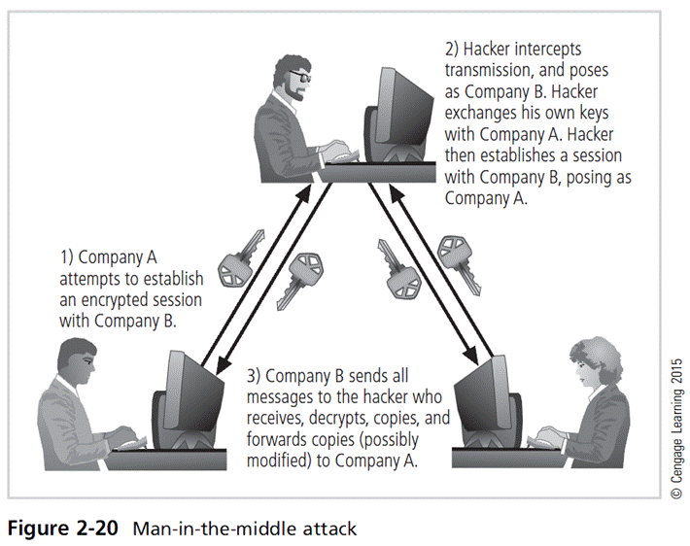
Principles of Information Security, Fifth Edition

Slide 41
Technical Hardware Failures or Errors
They occur when a manufacturer distributes equipment containing a known or unknown flaw.
They can cause the system to perform outside of expected parameters, resulting in unreliable service or lack of availability.
Some errors are terminal and some are intermittent.
Principles of Information Security, Fifth Edition
Notes:
Technical Hardware Failures or Errors
Occur when manufacturer distributes equipment containing known or unknown flaw
Can cause system to perform outside of expected parameters, resulting in unreliable service or lack of availabilitiy
Some errors are terminal; some are intermittent
Intel Pentium CPU failure
Mean time between failure measures amount of time between hardware failures

Slide 42
Technical Software Failures or Errors (cont’d)
Large quantities of computer code are written, debugged, published, and sold before all bugs are detected and resolved.
Combinations of certain software and hardware can reveal new software bugs.
Principles of Information Security, Fifth Edition
Notes:
Technical Software Failures or Errors
Much computer code written, debugged, published, and sold before all bugs detected and resolved
Combinations of certain software and hardware can reveal new software bugs
Entire Web sites dedicated to documenting bugs
Open Web Application Security Project (OWASP) dedicated to helping organizations create/operate trustworthy software, publishes list of top security risks

Slide 43
Theft
Illegal taking of another’s physical, electronic, or intellectual property
Physical theft is controlled relatively easily.
Electronic theft is a more complex problem; the evidence of crime is not readily apparent.
Principles of Information Security, Fifth Edition
Notes:
Deliberate Acts of Theft
Theft is the illegal taking of another’s property. Within an organization, that property can be physical, electronic, or intellectual.
The value of information suffers when it is copied and taken away without the owner’s knowledge.
Physical theft can be controlled quite easily. A wide variety of measures can be used from simple locked doors to trained security personnel and the installation of alarm systems.
Electronic theft, however, is a more complex problem to manage and control. Organizations may not even know it has occurred.

Slide 44
Secure Software Development
Many information security issues discussed here are caused by software elements of the system.
Development of software and systems is often accomplished using methodology such as systems development life cycle (SDLC)‏.
Many organizations recognize the need for security objectives in SDLC and have included procedures to create more secure software.
This software development approach is known as Software Assurance (SA)‏.
Principles of Information Security, Fifth Edition

Slide 45
Software Design Principles
Good software development results in secure products that meet all design specifications.
Some commonplace security principles:
  Keep design simple and small
  Access decisions by permission not exclusion
  Every access to every object checked for authority
  Design depends on possession of keys/passwords
  Protection mechanisms require two keys to unlock
  Programs/users utilize only necessary privileges
Principles of Information Security, Fifth Edition

Slide 46
Software Design Principles (cont’d)
Some commonplace security principles:
  Minimize mechanisms common to multiple users
  Human interface must be easy to use so users routinely/automatically use protection mechanisms.
Principles of Information Security, Fifth Edition

Slide 47
Summary
Unlike any other aspect of IT, information security’s primary mission is to ensure things stay the way they are.
Information security performs four important functions:
  Protects organization’s ability to function
  Enables safe operation of applications implemented on organization’s IT systems
  Protects data the organization collects and uses
  Safeguards the technology assets in use at the organization
Principles of Information Security, Fifth Edition

Slide 48
Summary (cont’d)
Threat: object, person, or other entity representing a constant danger to an asset
Management effectively protects its information through policy, education, training, and technology controls.
Attack: a deliberate act that exploits vulnerability
Secure systems require secure software.
Principles of Information Security, Fifth Edition

